Slide 1
Cosmos Deep Dive
by
Mary A Clark
maryfromcolorado@gmail.com
Sr Cloud Solutions Architect
Transamerica

Slide 2
Cosmos can be expensive
Creating one huge document containing mixed data; nested detail levels, history increases size which adds RUs via cost to inserts, updates, and queries
Microservices that have a more discrete set of processes can more easily adapt to this model
More transactional type systems with many updates will suffer if the collection items are too large and large #’s updates, so consider hybrid part sql server or splitting the document into multiple collections
Accepting the default indexing policy of everything adds RUs to cost of write operations. Thinking you can query any field as it is indexed leads to Cross partition queries - searching by fields that span many partitions
Not making use of secondary regions for read
Not handling 429s correctly
Provisioning more RUs than needed, especially on dev – and not making use of CreateOfferQuery to re-provision RUs temporarily.

Slide 3
Think about Base costs
Create RUs: 5.71
Read RUs: 1.00
Update RUs: 10.67
Delete RUs: 5.71

Slide 4
Watch document size and operations
Split large documents into multiple collections if multiple processes operating simultaneously on the same document
Master
Detail/ Nested Detail
Event History
This can reduce overall RUs, and cut down on 412s
Use NullValueHandling ignore on json serializer settings, then any null fields will not take up space in document e.g. “status” : null

Slide 5
Default indexing policy
{
"indexingMode": "consistent",
"automatic": true,
"includedPaths": [
{
"path": "/*"
}
],
"excludedPaths": [
{
"path": "/\"_etag\"/?"
}
]
}
Only include searched fields Id, and Dates etc that cannot be in a cross index collection.

Slide 6
Use cross index collections
Build other cross index collections using heavily searched fields
E.g. Customer and Orders scenario
Orders Index collection contains items keyed by customerId_IndexEnum which then contain list of order ids for that customer

Slide 7
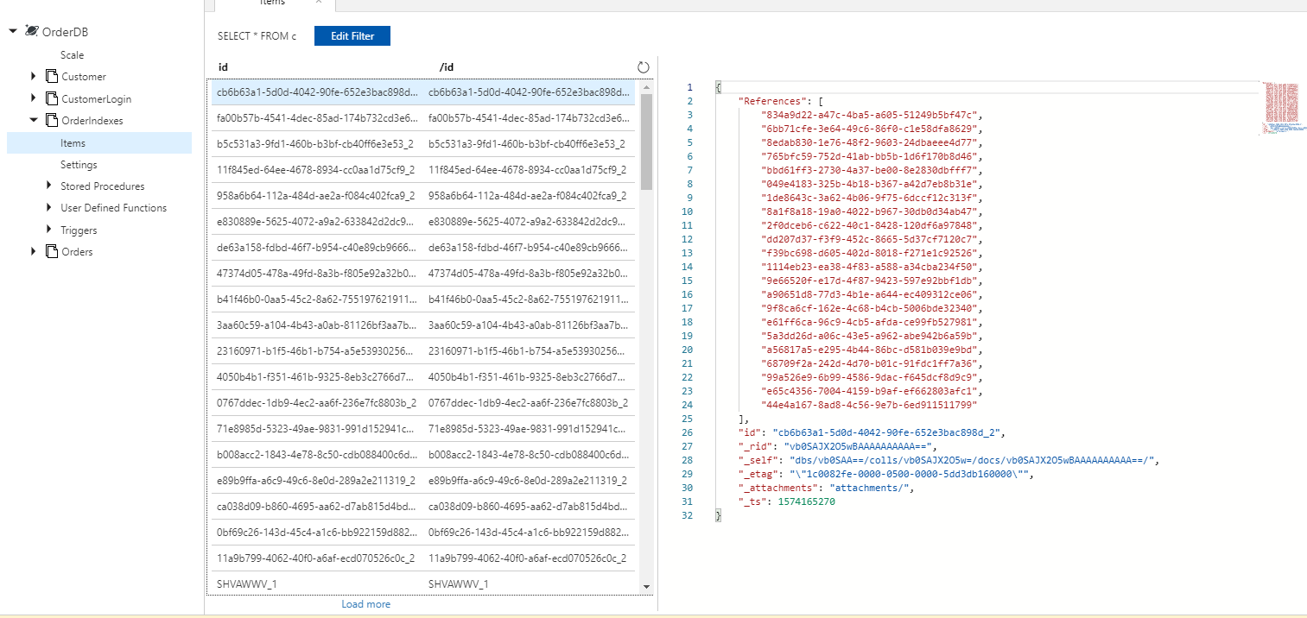
Cross Index Orders by customerid

Slide 8
Cache aside pattern
When you know you will have 1-N processes reading the new cosmos document to perform some operation, consider the cache aside pattern to save the read overhead.
Build into the repository implementation
GetById - Look in Redis cache
If found return the document
Else read from cosmos (and place in cache)
Update document
Update Cosmos
Update Cache

Slide 9
Secondary region
To obtain true cross region failure, you need to setup multi-region cosmos write/read or write/write so take advantage of using second region for read.
A website doing lookups
A process (webjob or function) that runs intermittently

Slide 10
Handle errors properly
Don’t put it back into the queue
429s (Busy) – use retryAfter flag
412s (Precondition failed) – Need to reread document and retry
Build 429 retries into cosmos repository base. Build retry for 412s into specific repository implementation

Slide 11
Provision correctly
Use lowest possible RUs settings, 400 for dev and test
Use temporary adjustments if needed for load testing. And then set it back
Use low-cost regions, not Australia central
Put policies in place if too many contributors.

